Slide 1
Convolution Neural Network (CNN)

Slide 2
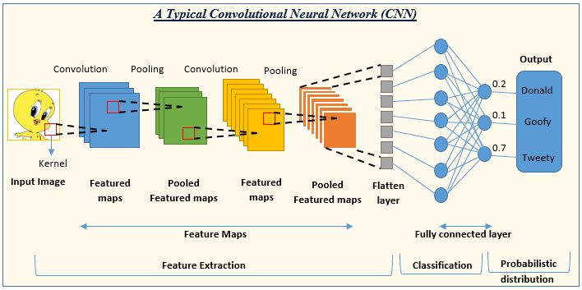
Convolution Neural Network (CNN)

Slide 3
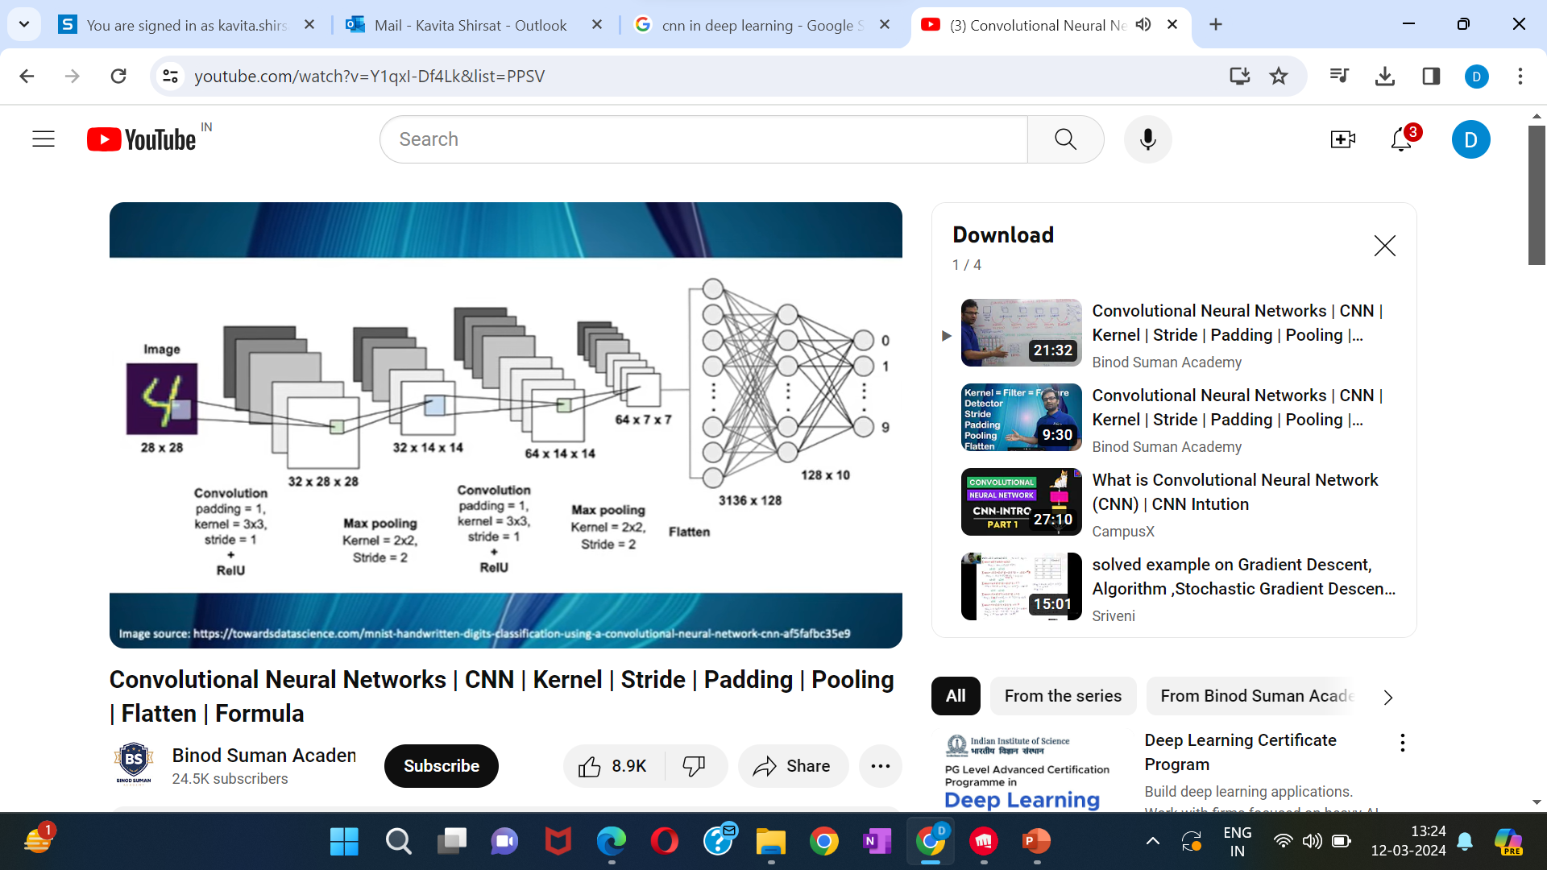
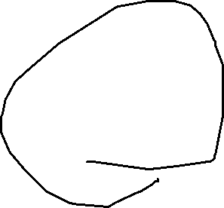
Convolution Neural Network (CNN)

Slide 4
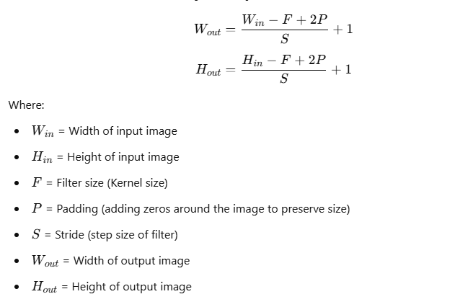
Output Size After Convolution Layer
Formula for Convolution Layer Output Size

Slide 5
Examples
1) Given:
Input Image Size = 32 × 32
Filter Size = 5 × 5
Stride = 1
Padding = 0 (no padding)
2) Input Image Size = 32 × 32
Filter Size = 5 × 5
Stride = 1
Padding = 2

Slide 6
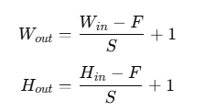
Output Size After Pooling Layer (Max/Average Pooling)
Pooling reduces the spatial dimensions of the image. The most common type is 2x2 Max Pooling
Where:
F = Pooling filter size (commonly 2×2)
S = Stride (commonly 2)

Slide 7
Max Pooling Layer
Given:
Input Image Size = 28 × 28 (from previous Convolution output)
Pooling Size = 2 × 2
Stride = 2
W out= (28-2)/2=(26/2)+1=14
Image size is :14*14

Slide 8
What is a Kernel in CNN
A kernel is a small matrix of weights (usually of size 3x3, 5x5, or 7x7) used to extract features like edges, colors, gradients, and textures from an image.
It performs a dot product operation with the input image, producing an output feature map (also called an activation map).
The kernel moves across the input image using a certain stride (step size).

Slide 9
Types of Kernels in CNN
Kernel Type | Purpose | Example
Edge Detection Kernel | Detects edges in images (horizontal, vertical) | Sobel, Prewitt, Scharr, Canny
Sharpening Kernel | Enhances edges and sharpens images | Laplacian Kernel
Blur Kernel | Blurs or smoothens the image | Gaussian Blur, Average Blur
Emboss Kernel | Highlights edges to give a 3D effect | Emboss Filter

Slide 10
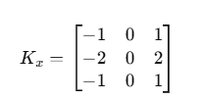
Edge Detection Kernel (for detecting edges in images)
When you want to detect edges like borders, boundaries, or outlines of objects in an image.
Useful in tasks like object detection, image segmentation, and feature extraction.
Example: Sobel Kernel for Horizontal Edge Detection
Kernel Matrix (3x3):
​​ This kernel detects horizontal edges in an image.

Slide 11
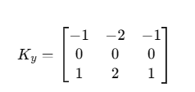
Vertical Edge Detection Kernel
This kernel detects vertical edges in an image.
Kernel Matrix (3x3):
Use Case:
Face detection (detect facial boundaries).
Number plate recognition (detect boundaries of the number plate).
Object recognition (detect outlines of objects).

Slide 12

Blurring Kernel (for blurring or smoothing an image)
This kernel smoothens the image by averaging pixel values around a central pixel.
Kernel Matrix (3x3):
Use Case:
Preprocessing images before feeding them to a CNN.
Reducing noise in medical images (X-ray, MRI).
Face recognition (to remove background noise).

Slide 13
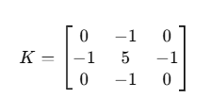
Sharpening Kernel (for enhancing edges and features)
When you want to enhance edges, textures, or fine details in an image.
Useful in object detection, face recognition, and medical imaging.
Kernel Matrix:
This kernel increases the contrast around edges, making objects sharper.
Use Case:
Medical imaging (highlight fractures in X-ray).
Object recognition (enhance object boundaries).
Image enhancement (sharpen blurry images)

Slide 14
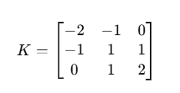
Emboss Kernel (for 3D effect)
When you want to give a 3D effect or depth to an image.
Useful in artistic image processing, texture analysis, or stylized filters.
Kernel Matrix:
This kernel highlights the edges by giving them a raised or embossed look.
Artistic image processing.
Texture analysis.
3D effect generation.

Slide 15

Identity Kernel (No effect, just pass the image as it is)
When you want to simply pass the image as it is without modification.
This kernel is useful in preprocessing pipelines when you don’t want to alter the image.
Kernel Matrix:
The image will remain unchanged after applying this kernel.
Use Case:
No change in the image.
Passing input directly to CNN without modification

Slide 16
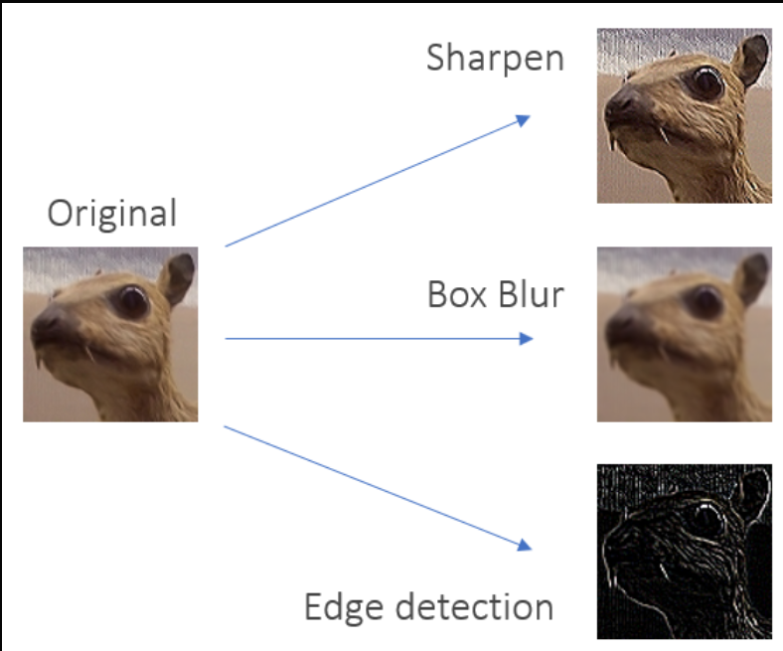
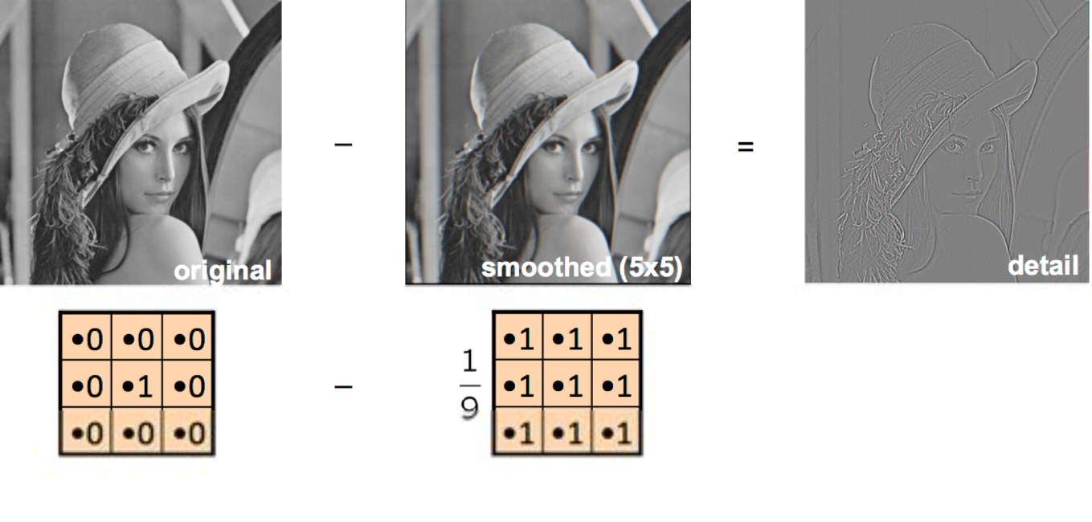

Slide 17
